Slide 1

Targeting Immune Checkpoint Therapy Resistance with Novel MSC-Engineered Extracellular Vesicles
Yves Greatti
April 29, 2024
Notes:
Today I will introduce my project which consists in designing a novel cancer drug using Mesenchymal Stem Cell-derived Extracellular Vesicles or EVs.

Slide 2
Agenda
Significance
Innovation
Research Strategy
Testing and Validation
Notes:
The agenda consists in 4 parts, starting with significance.

Slide 3
Significance

Slide 4
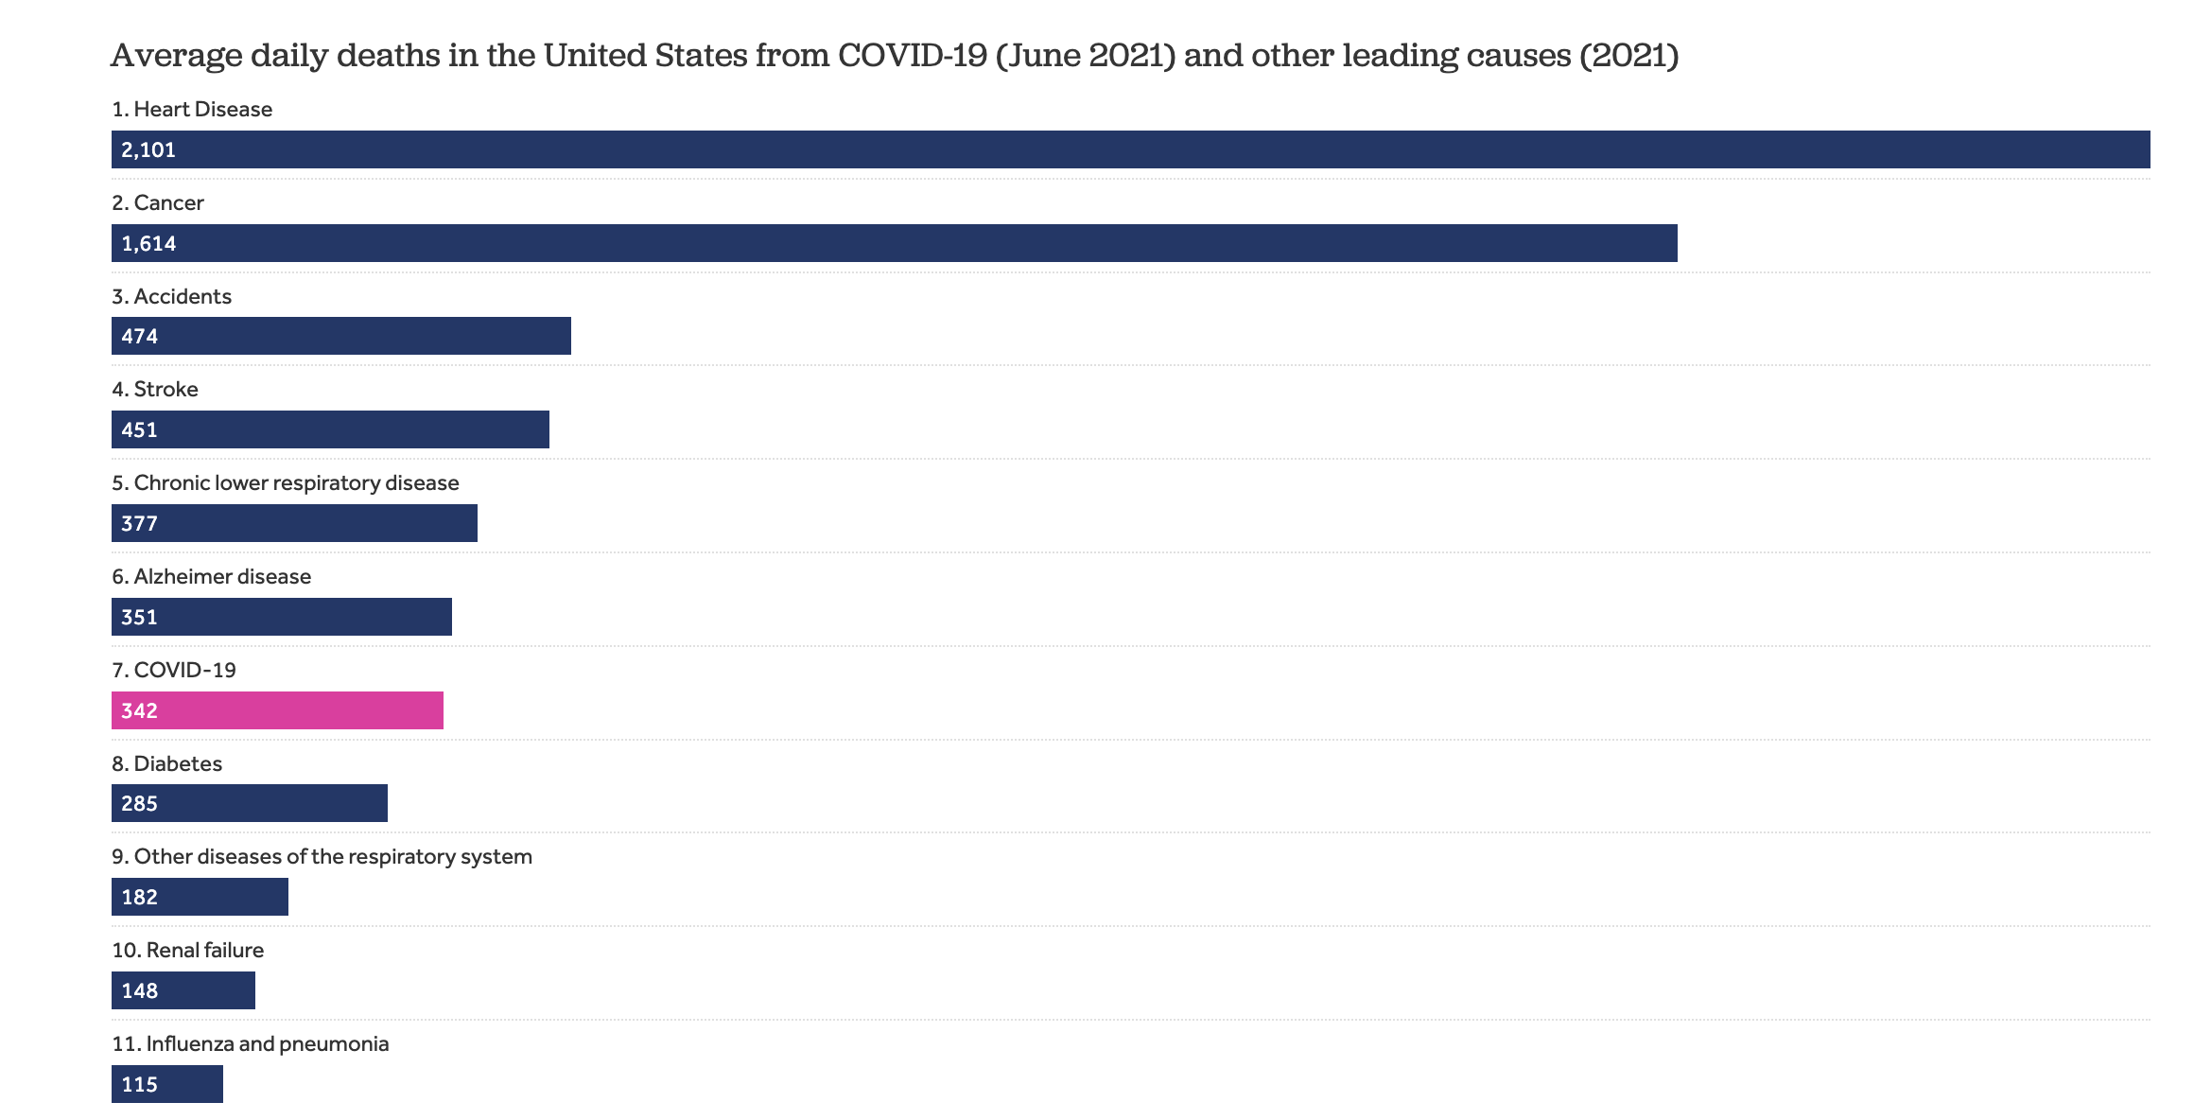
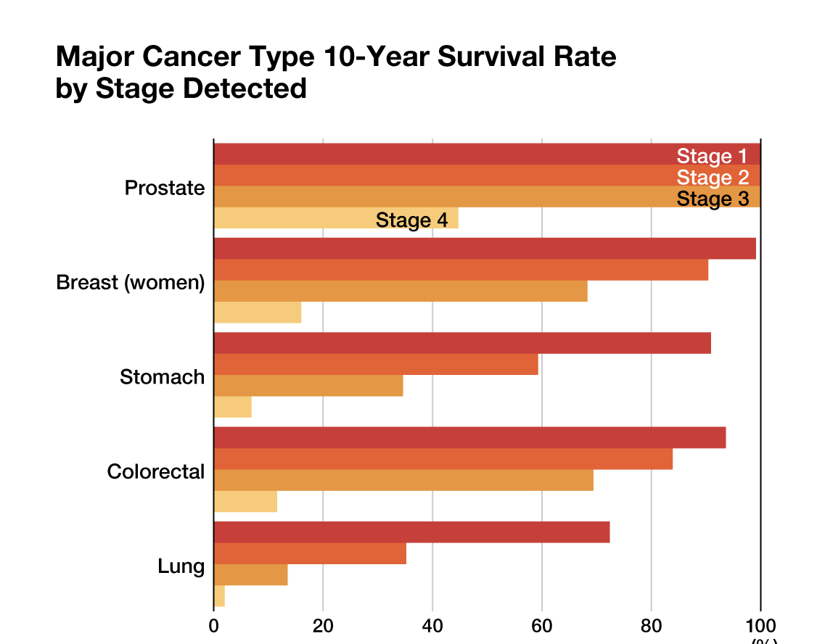
The Persistent Challenge of Cancer Today
2024-cancer-facts-and-figures-acs
Notes:
Although there have been significant improvements in reducing lethality of cancer, it remains yet a prevalent disease in the US. As you can see in the left chart, at the peak of the pandemic, cancer was ranked number 2 in term of average daily deaths and on the right there is a steep decline in survival rate for people with stage 4 across different cancer indications.

Slide 5
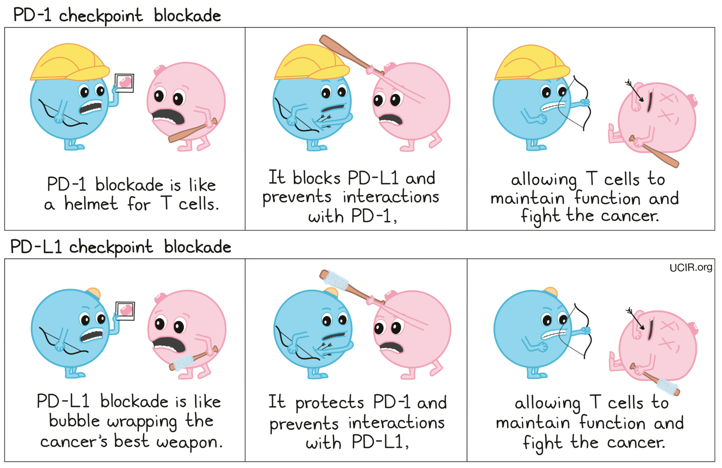
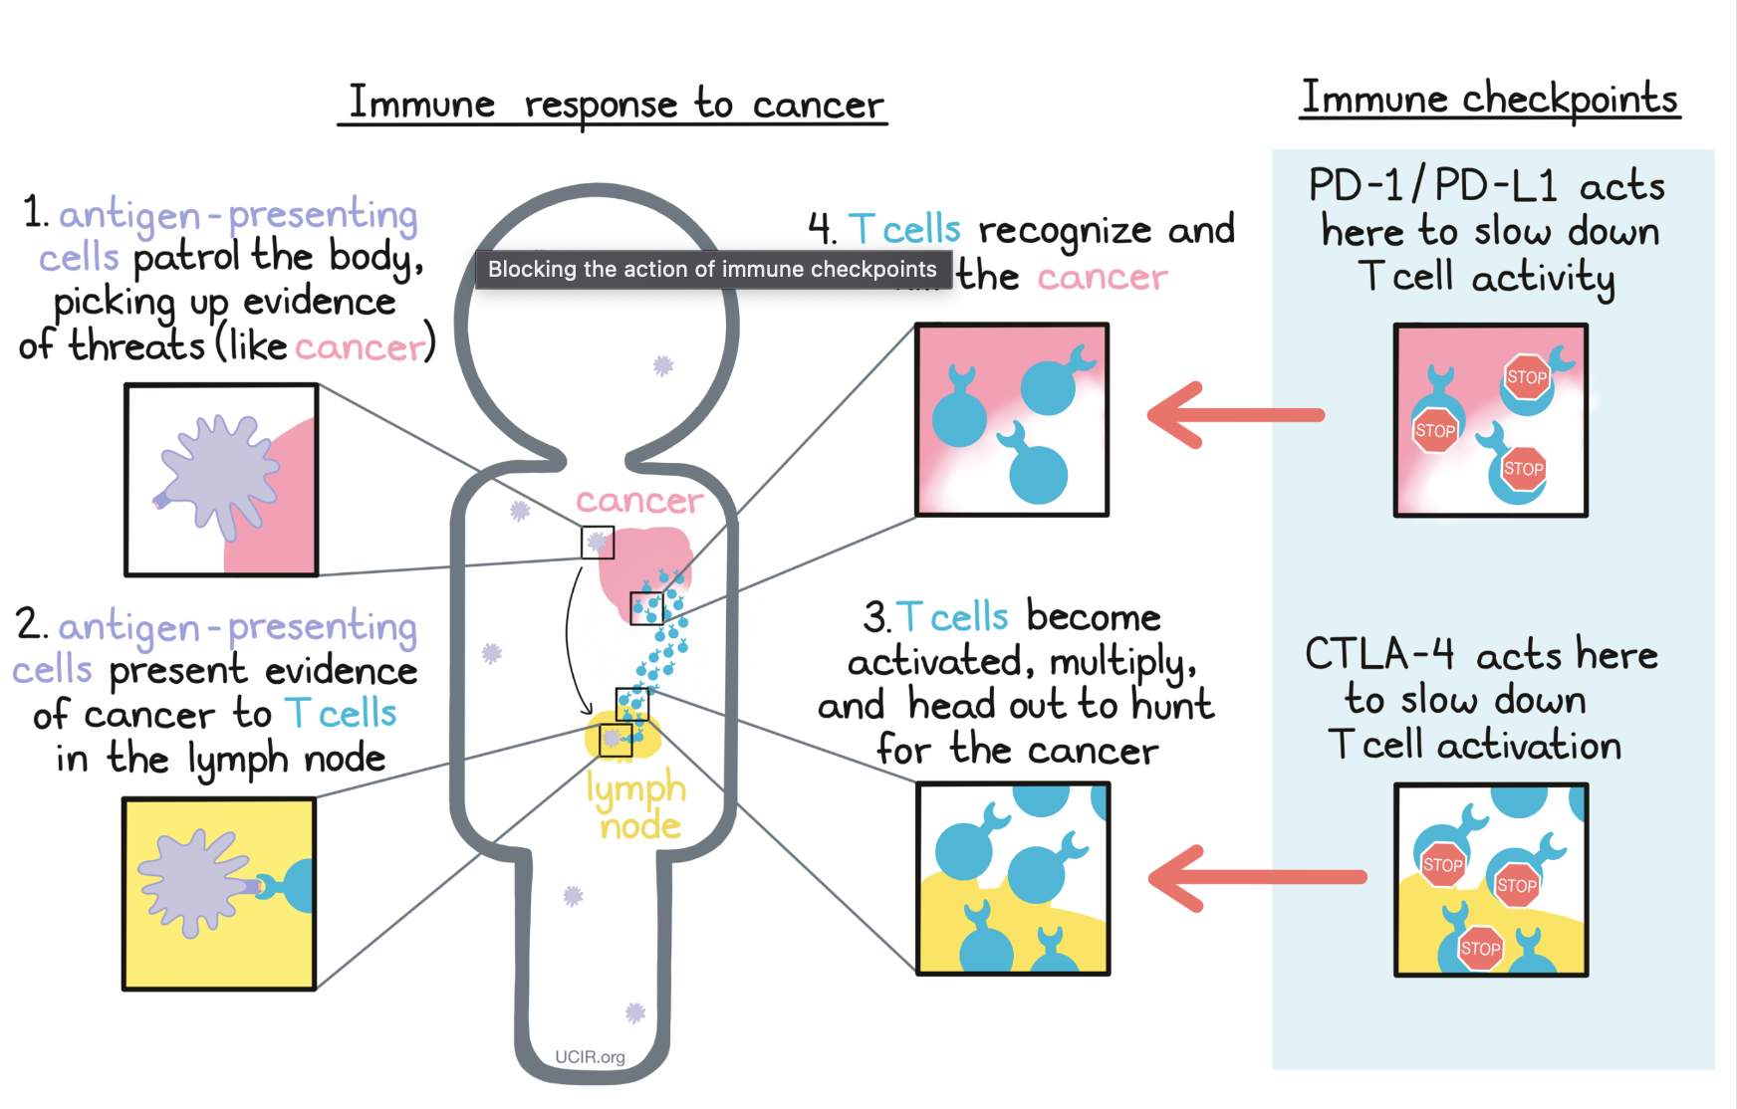
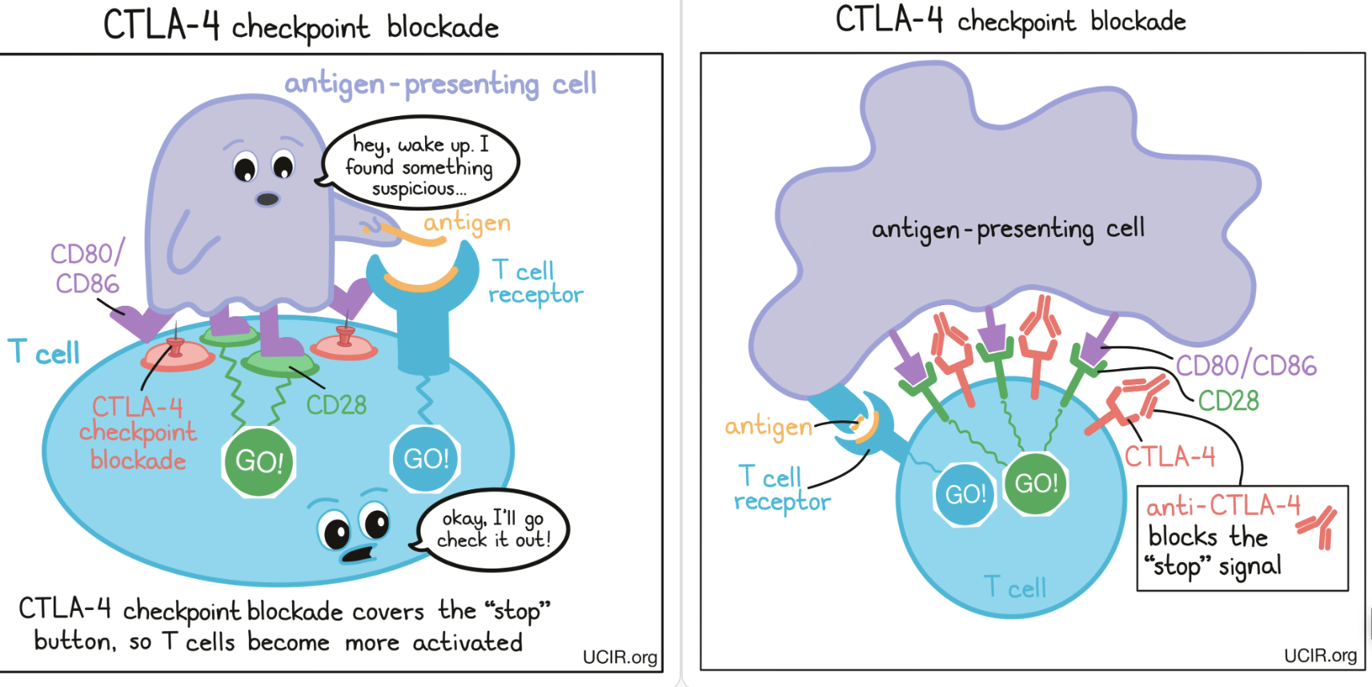
Immune Checkpoint Blockade Therapy
Notes:
let's start with a quick review of two of the most successful immune checkpoint inhibitors and their mechanism of action.
In a healthy immune response, CTLA-4 functions as a brake on T cells to prevent overactivation
Tumors can encourags expression of CTLA-4.
Anti-CTLA-4 therapies are designed so that they specifically bind to CTLA-4, and by blocking CTLA-4, the therapies ensure that T cell activation is restored.
On the other hand, PD-1 is a receptor found on the surface of T cells. And its ligands, PD-L1 and PD-L2, can be expressed on the surface of tumor cells.
Many types of cancer upregulate PD-L1, "instructing" T cells to turn off.
PD1-/PD-L1 immunotherapies, can either bind to PD-1 or PD-L1, blocking their ability to send inhibitory signals to T cells.

Slide 6
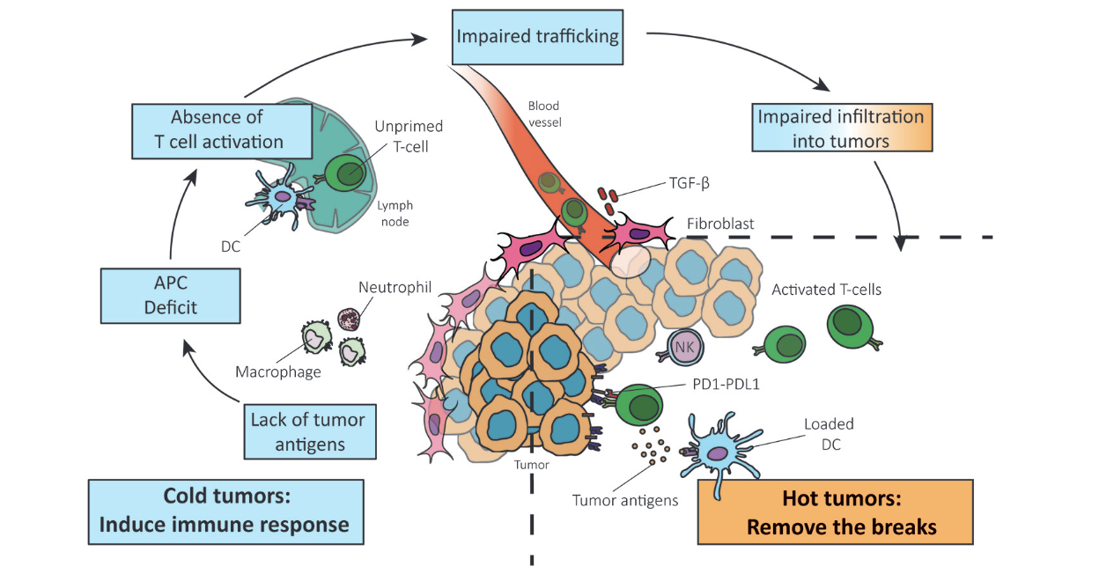
Reversing a Cold Tumor Into a Hot Tumor
Notes:
In "hot" tumors, the main challenge is overcoming the inhibition of the immune response that is induced by the cancer cells.
Recent immunotherapies have seen substantial success in treating "hot" tumors but have been far less effective for "cold" tumors.
In the early stage, cancer is able to evade the immune system by not presenting significant neoantigens.
The second stage of immune response to the tumor involves the presentation of these tumor antigens by dendritic cells (DCs), which leads to the priming and activation of T cells that can attack the cancer.
However, the lack of tumor antigen results in a deficiency in the recruitment of antigen presenting cells (APCs).
This, in turn, leads to a lack of co-stimulation and activation of T cells.
Moreover, altered production of chemokines and cytokines, can affect cell trafficking and infiltration.
All these factors result in the exclusion of CD8+ T cells by the stroma of the tumor.
The stroma environment prevents T cells from reaching the cancer cells.
The drug we designed addresses the challenge presented by cold tumor and strengthen the effects of immune checkpoint inhibitors.

Slide 7
Agenda
Significance
Innovation
Research Strategy
Testing and Validation

Slide 8
Innovation

Slide 9
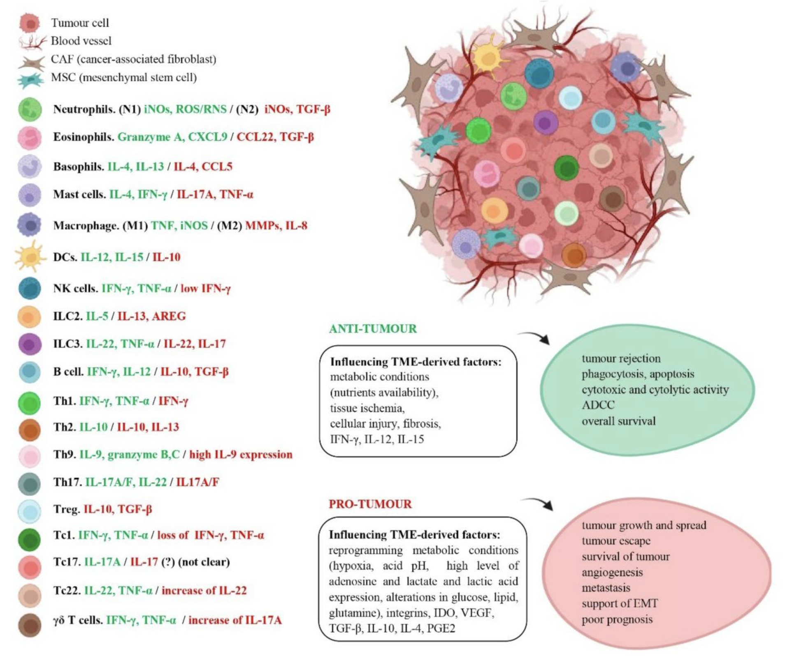
Dual-activities of the Immune System
A. C. Peña-Romero et al., “Dual Effect of Immune Cells within Tumour Microenvironment: Pro- and Anti-Tumour Effects and Their Triggers
Notes:
Immune cells can behave as guardians (they have anti-tumor immunity) or as supporters of the tumor (they are pro-tumor) which makes them a “double-edged sword” in the Tumor Microenvironment or TME.
On the left, the cytokines secreted by the different types of immune cells are shown in green and those released in pro-tumor activity in red. In some cases, as you can see the same cytokine has dual effect.
On the right, you find TME-derived factors, which influence immune cell fate, and also could be anti-tumor and pro-tumor factors.

Slide 10
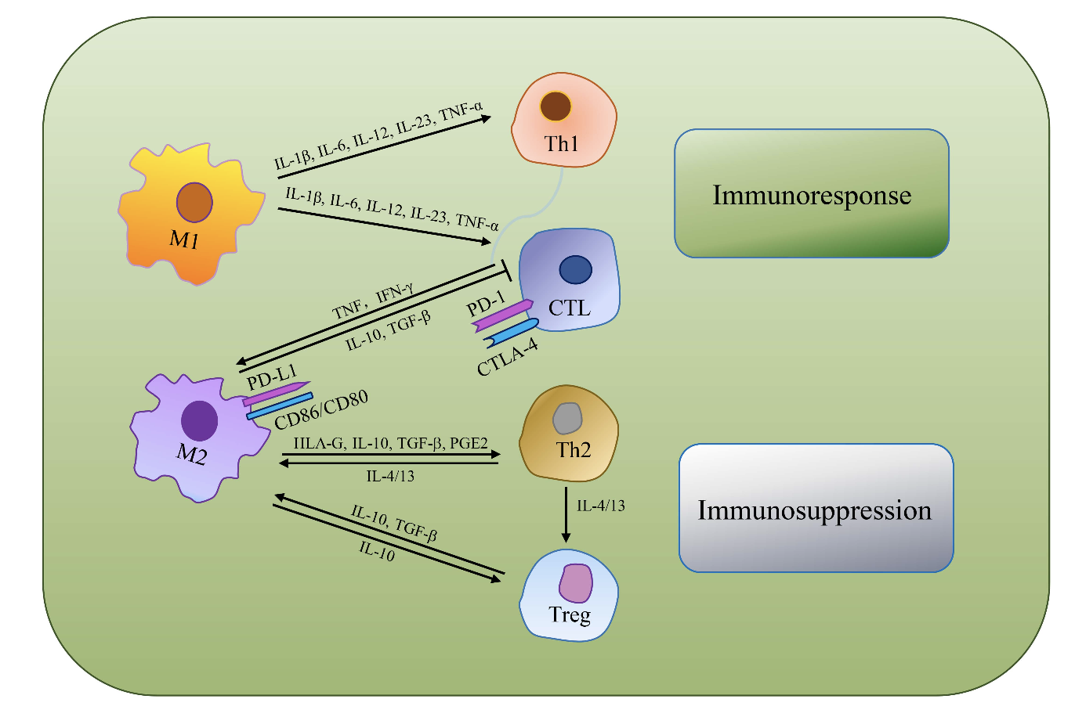
Tumor Associated Macrophages (TAMs)
TAMs as the most dominant immune cell type, are an indispensable target for immunologically cold tumor
Tong et al., “Tumor Associated Macrophages, as the Dominant Immune Cells, Are an Indispensable Target for Immunologically Cold Tumor—Glioma Therapy?”
Notes:
Among the immune cells which play a significant role in cancer biology, there are the tumor associated macrophages or TAMs. They influence tumor growth, angiogenesis, metastasis, and the suppression of antitumor immunity.
These macrophages can have either M1-like or M2-like phenotypes.
M2 macrophages can secrete human leukocyte antigen-G (HLA-G), TGF-β, or PGE2 and other immunosuppressive molecules, which directly inhibit immune response.
M2s through a variety of cytokines such as IL-10 , supports Th2 cell differentiation which induces regulatory T cells (Tregs) amplification.
Also, M2 macrophages can suppress CTLs (cytotoxic T lymphocytes) via TGF-β and IL-10 production.
M1-like has an anti-tumor role and this is the macrophages we are looking to induce in our drug.

Slide 11
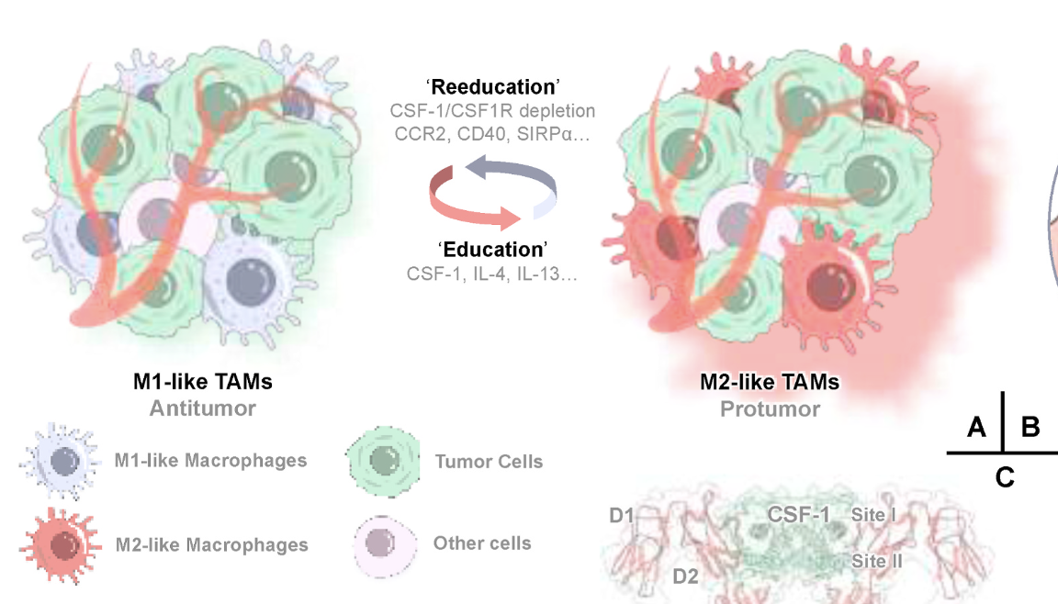
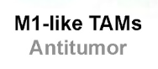
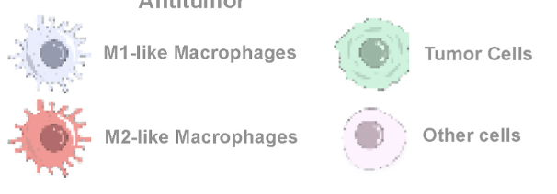
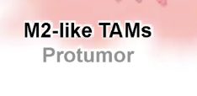
CSF-1/CSF1R Inhibitors modify TAMs behavior within the TME
CSF1R inhibitors are emerging immunotherapeutic drugs for cancer treatment. Jiachen Wen et al.
Notes:
This slide shows the strategic use of CSF-1R inhibitors to modify the behavior of TAMs within the tumor microenvironment.
Macrophages polarize into two subtypes following infiltration to tumor tissue, with M1-like macrophages characterized by biomarkers of CCR7, CD40, CD11c, and M2-like macrophages by markers of CD169, or CD206.
M1-like and M2-like TAMs, have the capacity transition between each other under stimulation of various cytokines and chemokines termed here as
‘education’ or ‘reeducation’ factors.

Slide 12
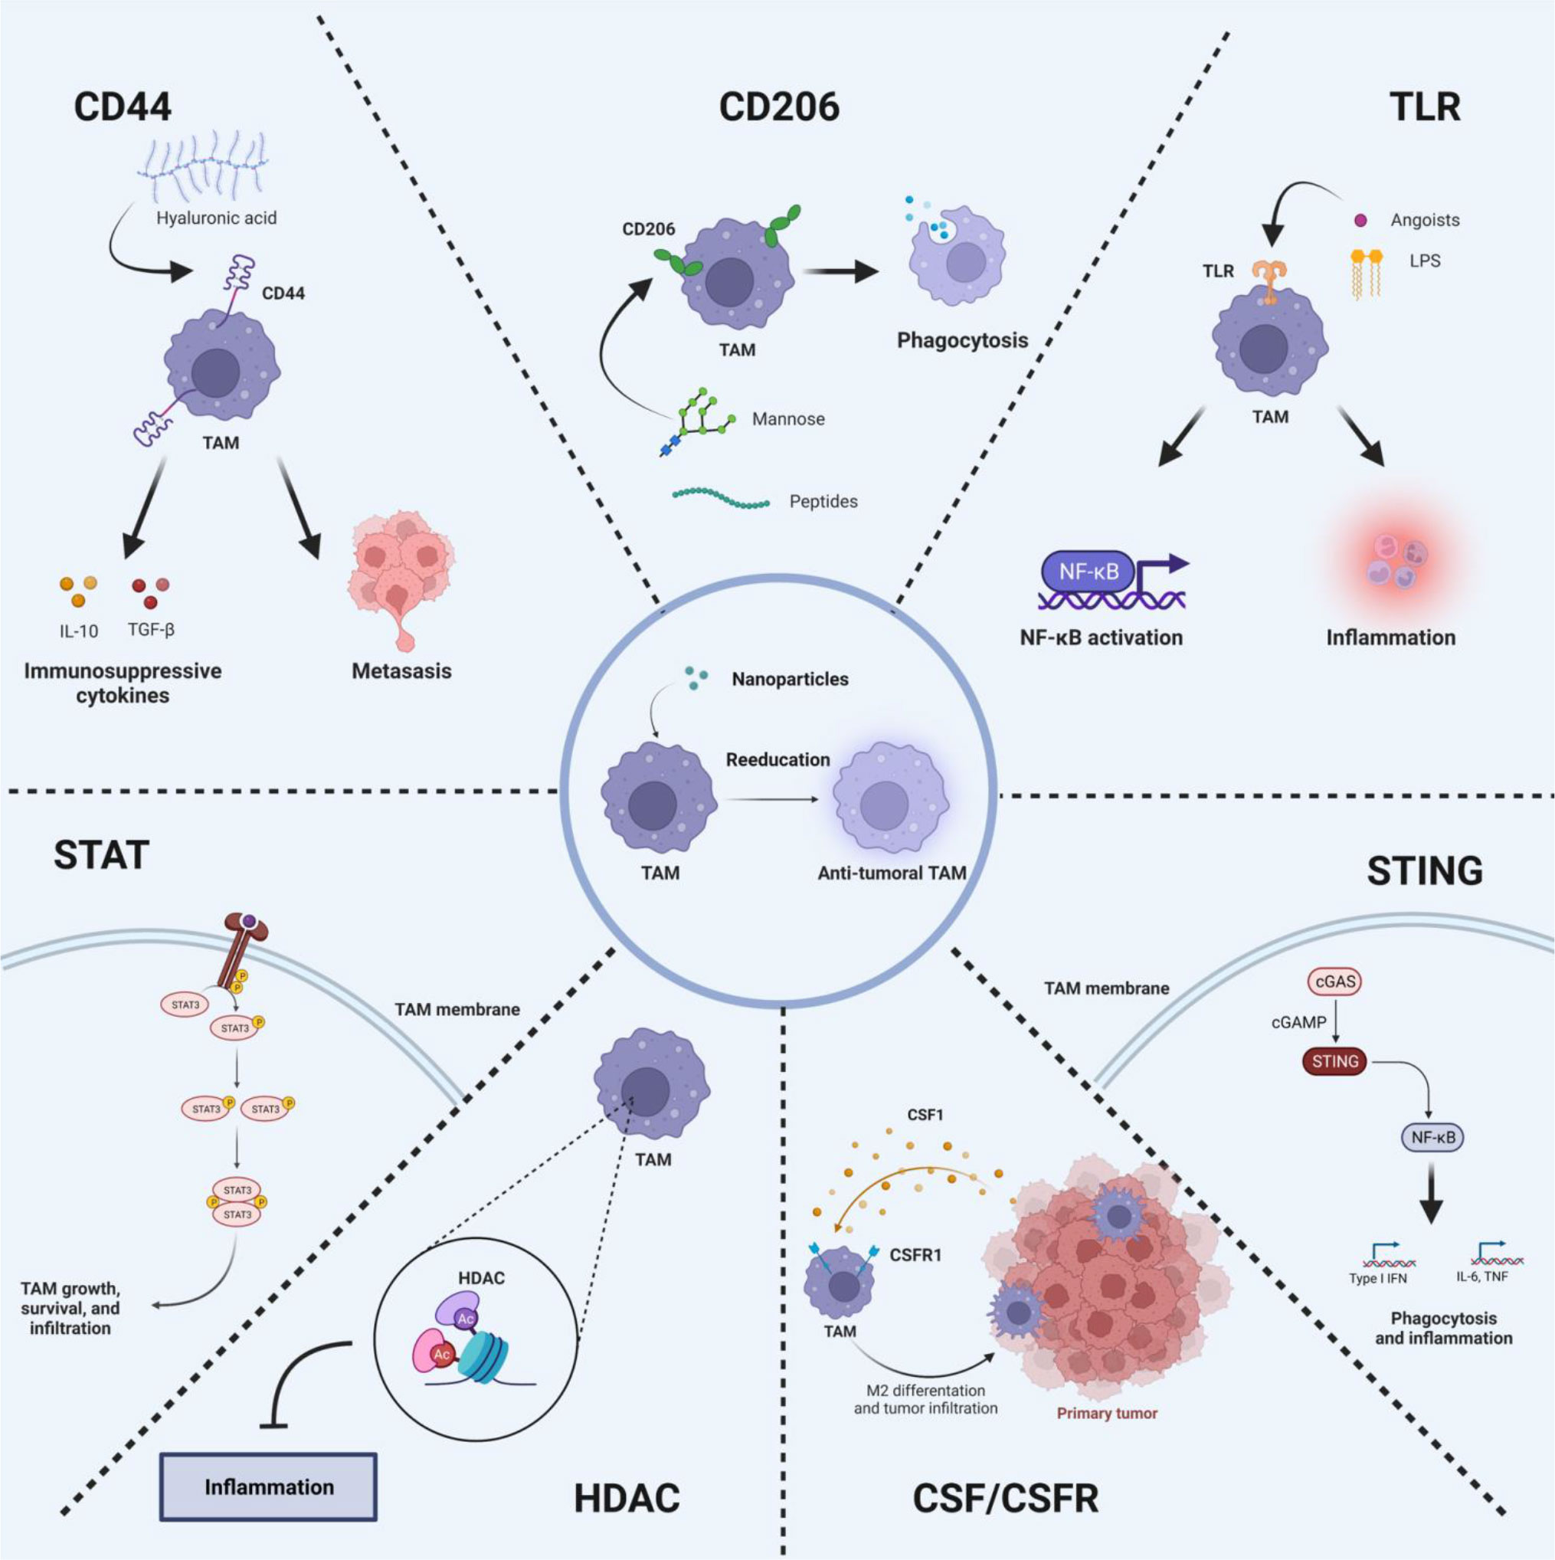
Strategies to reeducate TAMs
X. Shen et al., “TAM-targeted reeducation for enhanced cancer immunotherapy: Mechanism and recent progress,”
Notes:
Two very important pathways in TAM differentiation are:
Toll-like Receptors or TLRs are a class of pattern recognition receptors that can detect the substances derived from invading pathogens, which
play essential roles in innate immunity and inflammatory responses.
Colony Stimulating Factor-1(CSF-1), is a cytokine considered as a major growth factor regulating the production, differentiation
and function of TAMs. CSF-1 is associated with tumor progression, metastasis, angiogenesis, and treatment resistance.

Slide 13
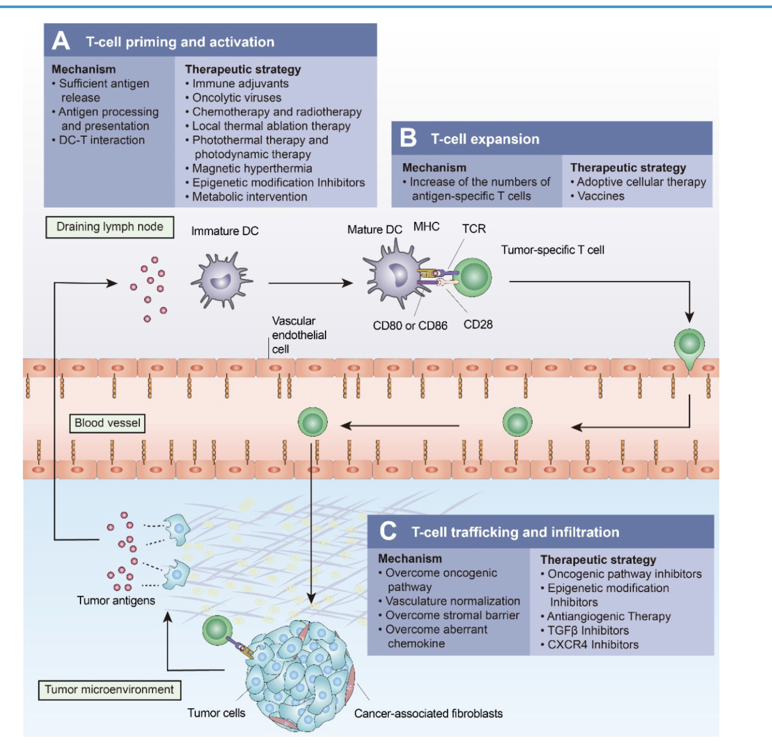
Strategies to Overcome the Challenges Presented by “Cold” Tumors
Proposed
Therapeutic Agent
Turning cold tumors into hot tumors by improving T cell infiltration
Yuan-Tong Liu, Zhi-Jun Sun doi: 10.7150/thno.58390
Notes:
There are numerous strategies which are listed here to improve the efficacy of
immune checkpoint therapies :
For instance
Oncolytic viruses-based vaccine, chemotherapy and radiotherapy are capable of inducing immunogenic cell death to promote T-cell priming and activation.
(B) Cancer vaccines and cellular therapies, such as CAR-T cells, which promote the expansion of tumor-specific T lymphocytes.
(C) You find therapies such as oncogenic pathway inhibitors, antiangiogenic therapies, TGFβ inhibitors

Slide 14
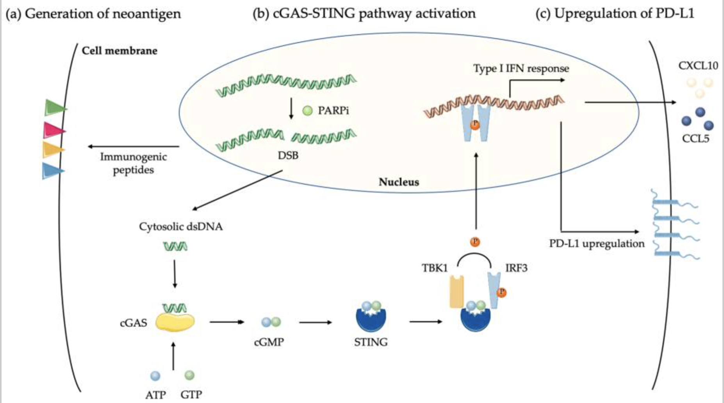
Biological effects of PARP Inhibitor on Cancer Cells
F. Peyraud and A. Italiano, “Combined PARP Inhibition and Immune Checkpoint Therapy in Solid Tumors” .
Notes:
PARP inhibitors (PARPi) operate by delaying the repair of DNA, which results in severe DNA damage in cancer cells. This increases the presence of neoantigens and the tumor mutation burden.
PARPi induction double-stranded breaks or DSB in tumor cells, results in the creation of DNA fragments.
These fragments, when they bind to cyclic GMP-AMP synthase (cGAS), activate the STING pathway. This activation triggers a type of interferon response, causing an increase in CCL5 and CXCL10 chemokines that help in the recruitment of T cells.
The STING pathway also triggers an increase in PD-L1, which could have a synergistic effect with an anti-PD1/PD-L1 ICI therapy.

Slide 15
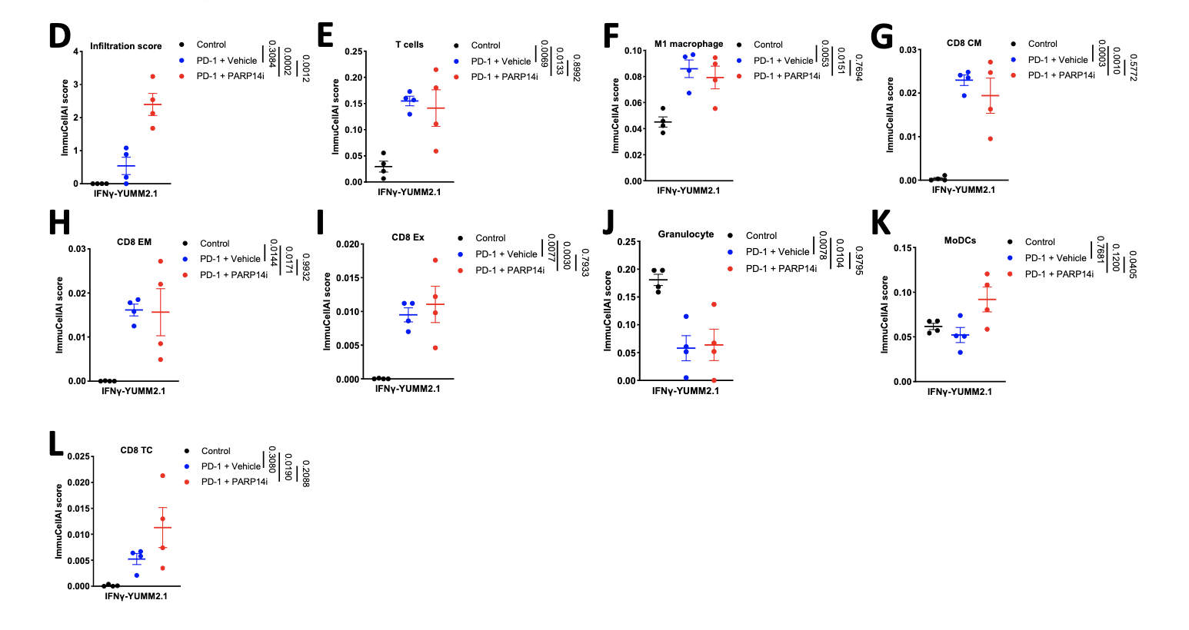
PARP14i Reverses Acquired Resistance to PD-1 Therapy
Effector T cell infiltration is
enhanced in tumors derived from cells pre-treated with IFNγ in immuno-
competent female mice when PARP14 is pharmacologically inhibited or
knocked down, while the presence of regulatory T cells is decreased, leading to
restoration of α-PD-1 sensitivity
C. W. Wong et al., “PARP14 inhibition restores PD-1 immune checkpoint inhibitor response following IFNγ-driven acquired resistance in preclinical cancer models,” Nat. Commun., vol. 14, no. 1, p. 5983, 2023, doi: 10.1038/s41467-023-41737-1
Notes:
D: infiltration, E: T cell, F: M1 macrophage,
G: CD8 central memory (CM) T cells, H: CD8 effector memory (EM) T cells,
I: exhausted (Ex) CD8 T cells, J: Granulocytes, K: Myeloid Dendritic cell (MoDC),
L: CD8 cytotoxic T cell (Tc).

Slide 16
Agenda
Significance
Innovation
Research Strategy
Testing and Validation

Slide 17
Research Strategy

Slide 18
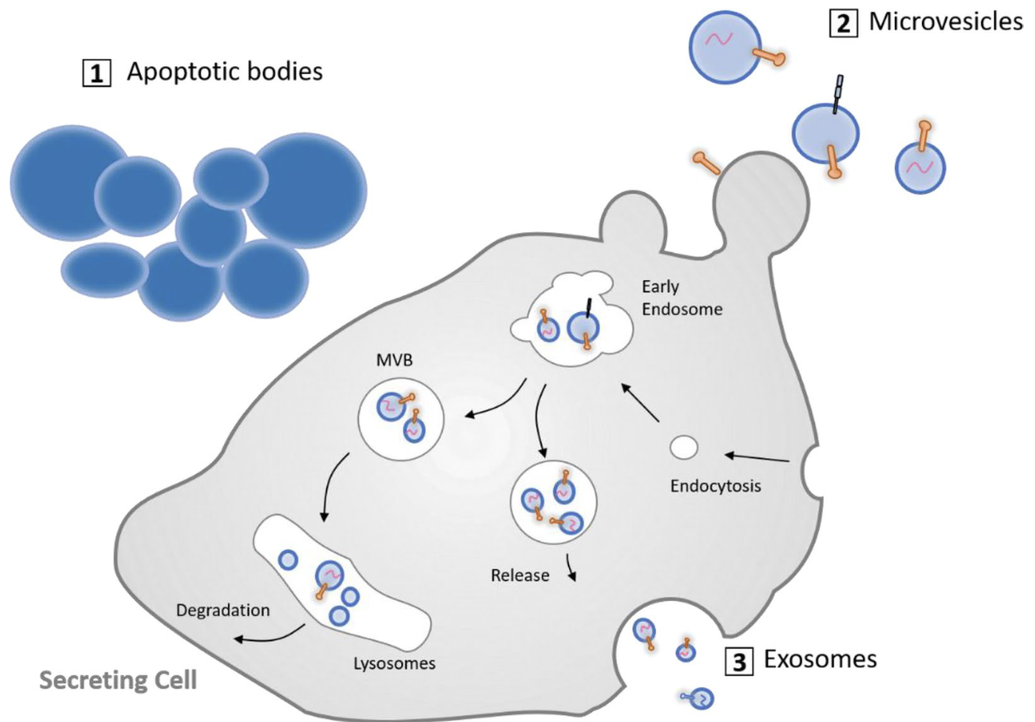
Therapeutic Potential of Mesenchymal Stem Cell-Derived Extracellular Vesicles
MSCs are favored as sources of EVs due to:
Ability to modulate the immune response
Promote tissue repair and regeneration
Low immunogenicity
Engineering flexibility
Scalable production
Notes:
Microvesicles
Size: Typically larger than exosomes, ranging from 100 to 1000 nm in diameter.
Features: Microvesicles carry a variety of biomolecules, including proteins and lipids, and also encapsulate nucleic acids and cytosolic components.
Exosomes
Size: Typically 30-100 nm in diameter.
Features: Exosomes are rich in nucleic acids, proteins, and lipids. They naturally encapsulate these molecules, making them excellent carriers for small molecule drugs, RNA, or other therapeutic agents.
Usage: Due to their small size and composition, exosomes can cross biological barriers such as the blood-brain barrier, making them ideal for targeting drugs to specific sites, including the brain.

Slide 19
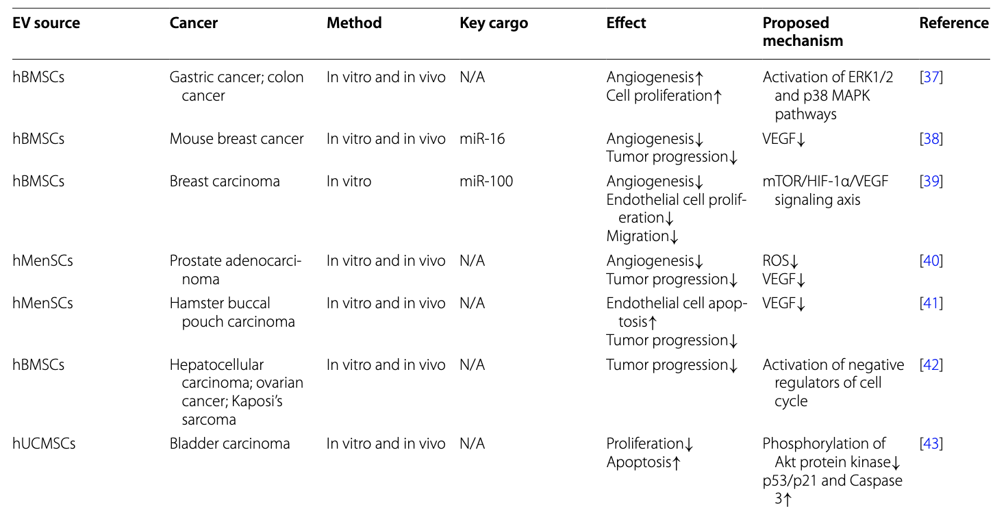
Effects of MSC-derived EVs on Different Types of Cancers
iPSC-MSC-EV Advantages
Anti-Inflammatory Bioactivity
Scalability
Donor Availability
Could induce M2-like transition
Z. Weng et al., “Therapeutic roles of mesenchymal stem cell-derived extracellular vesicles in cancer,” J. Hematol. Oncol., vol. 14, no. 1, p. 136, 2021, doi: 10.1186/s13045-021-01141-y
Notes:
There have been a lot of research to understand which MSCs are suitable for secreting exosomes adequate for cancer.
Induced pluripotent stem cells (iPSCs) are a type of pluripotent cells that can be derived from adult somatic cells and propagate indefinitely.

Slide 20
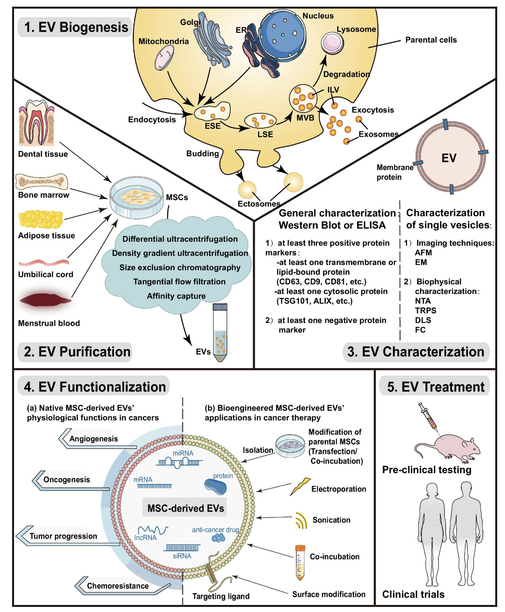
Key steps in the process of Engineering MSC-derived EVs’ Therapeutic Applications
There are well-established and reliable methods for engineering MSC-derived EVs
Z. Weng et al., “Therapeutic roles of mesenchymal stem cell-derived extracellular vesicles in cancer,” J. Hematol. Oncol., vol. 14, no. 1, p. 136, 2021, doi: 10.1186/s13045-021-01141-y

Slide 21
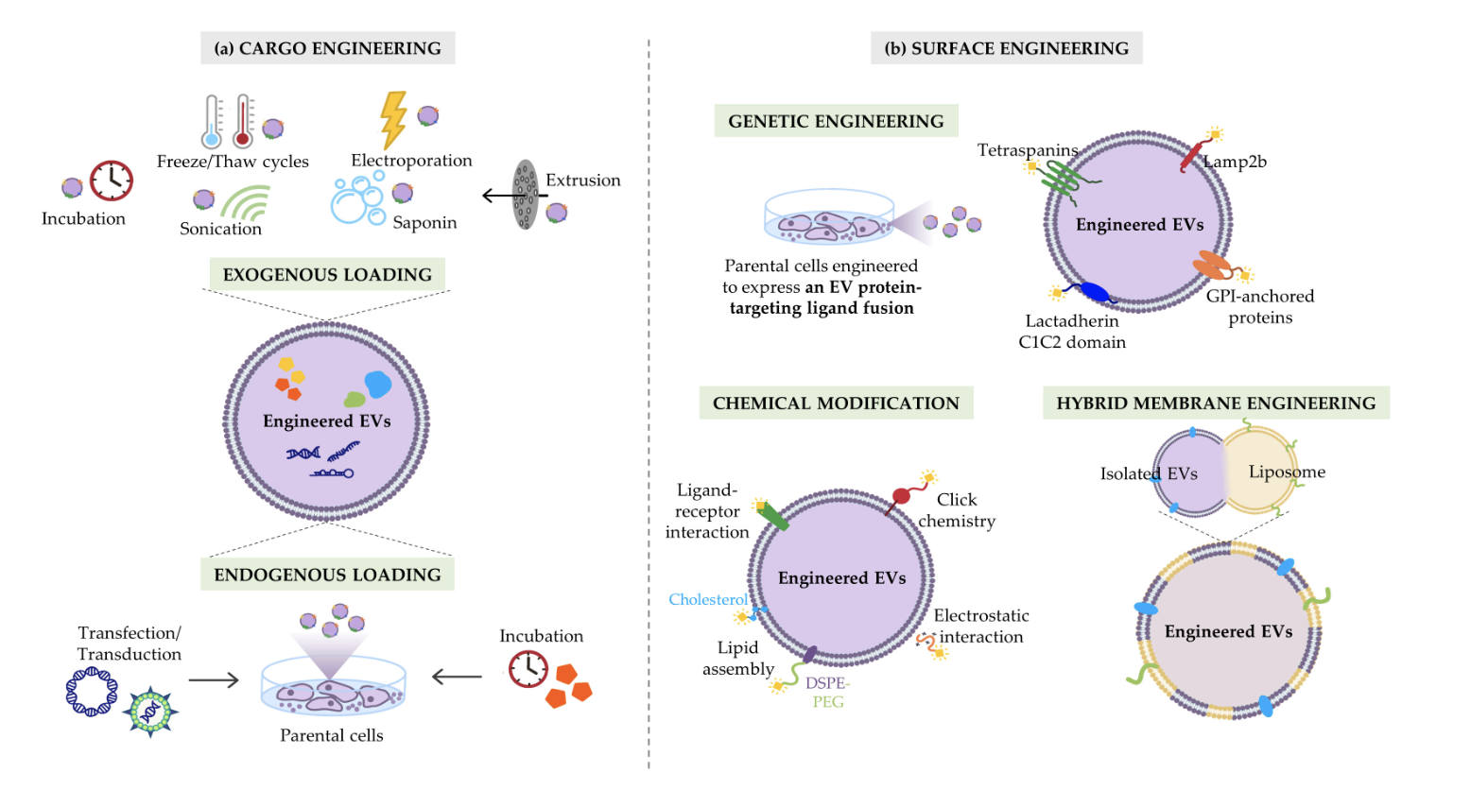
Strategies to maximize the therapeutic efficacy of EVs
Click Chemistry: Ideal for attaching small molecules to exosomes due to its high specificity and yield.
Lipid Anchoring: Small molecule agonists or inhibitors can be modified to include lipid tails, facilitating their integration into the exosome lipid bilayer.
Nanocarrier Encapsulation: Encapsulate the drug within exosomes to protect the active agents from degradation and ensure targeted delivery.
Cristiana Ulpiano et al., “Bioengineered Mesenchymal-Stromal-Cell-Derived Extracellular Vesicles as an Improved Drug Delivery System:Methods and Applications

Slide 22
Methodology for the design of the MSC-derived EV Therapeutic Agent
1. Enrich the M1 population of tumor-associated macrophages (TAMs) and modulate TAM recruitment and distribution.
Approach: Utilize chemical conjugation techniques to attach R848 to the exosome surface.
2. Create dual-targeting exosomes that selectively target TAMs while evading the immune system via CD47 expression, which signals "don't eat me" to phagocytes.
Approach: Combine CD47 Expression with TAM-Specific Ligands.
Introduce vectors encoding CD47 into cell cultures that will be used to harvest exosomes. Use covalent attachment to attach antibodies against M2-like TAM marker CD80 to the exosome surface.
3. Ensure that exosomes are sufficiently expressing CD47 to avoid uptake macrophages and dendritic cells of the MPS without impairing the ability to target specific cells at the tumor site.
Approach: optimize the level of CD47 expression on exosomes using a promoter with adjustable strength to find the right balance where exosomes can evade phagocytosis without completely inhibiting macrophage interaction where needed.
4. Modify the R848 molecule for pH-sensitive release near the cancer cells.
Approach: Synthesize a peptide linker that is sensitive to the acidic pH typical of tumor environments. This peptide should include a sequence specific to the matrix metalloproteinase-2 (MMP-2), which is often overexpressed in tumor tissues.
Notes:
The peptide linker will be synthesized such that one end has a functional for attachment to R848, and the other end can be conjugated to the exosome surface or another suitable carrier.
Integrate a sequence that is specifically recognized and cleaved by MMP-2. MMP-2 recognizes and cleaves peptides containing a specific sequence of amino acids. For example, a commonly used sequence for MMP-2 sensitivity is 'GPLGVRG’.
Once the peptide-linked R848 is localized near the tumor cells (where MMP-2 expression is high), MMP-2 enzymes will cleave the peptide at the specific recognition site ('GPLGVRG’).
This cleavage releases R848 in an active form precisely at the site where MMP-2 is overexpressed.

Slide 23
Agenda
Significance
Innovation
Research Strategy
Testing and Validation

Slide 24
Testing and Validation

Slide 25
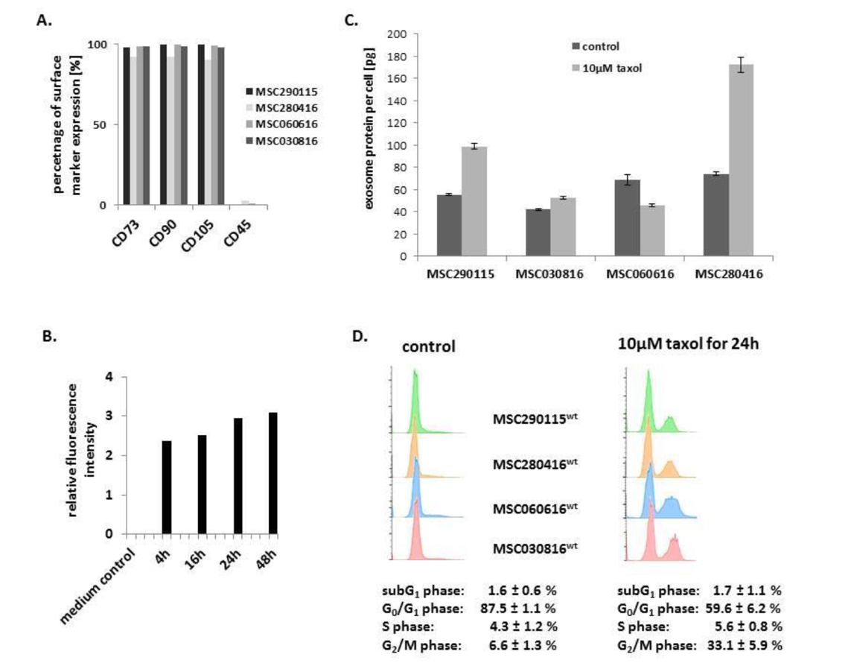
Assessment of Cytotoxic Effects of Engineered Exosomes Produced by MSCs
A) Characterization of four different MSC investigated populations.
B) Kinetic of exosomes production by MSC^{GFP}: progressive exosome release increase to reach a plateau after 24h.
C) Quantification of exosome produced per cell within a specific timeframe.
D) Apoptotic/necroptotic subG1 phase cells should remain at equally low levels in control and drug treated MSC populations: confirming no detectable cytotoxic effects.
Catharina Melzer et al., “Taxol-Loaded MSC-Derived Exosomes Provide a Therapeutic Vehicle to Target Metastatic Breast Cancer and Other Carcinoma Cells”
Notes:
\

Slide 26
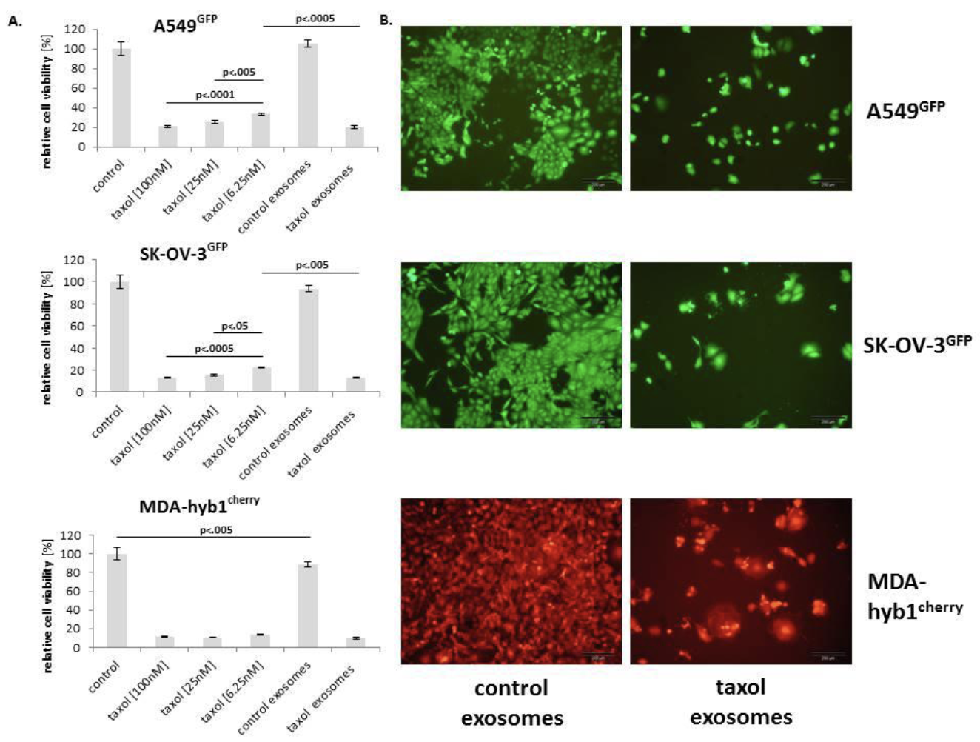
Therapeutic Response Assessment of Engineered Exosomes on a Panel of Cancer Cell Lines In Vitro
Relative chemotherapeutic response of different human cancer cell populations, including:
A549GFP lung cancer (upper panel),
SK-OV-3GFP ovarian cancer (middle panel),
MDA-hyb1cherry breast cancer (lower panel) cells
Catharina Melzer et al., “Taxol-Loaded MSC-Derived Exosomes Provide a Therapeutic Vehicle to Target Metastatic Breast Cancer and Other Carcinoma Cells”
Notes:
\

Slide 27
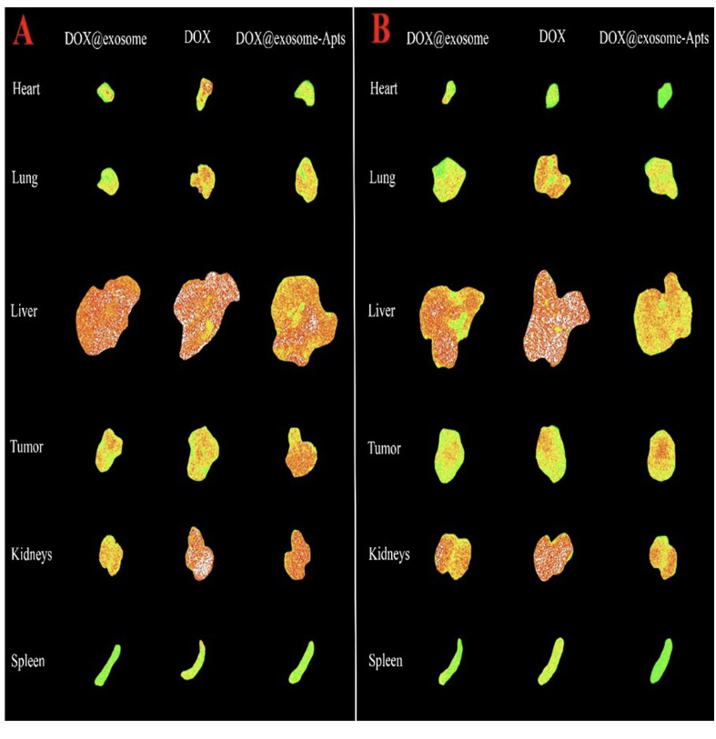
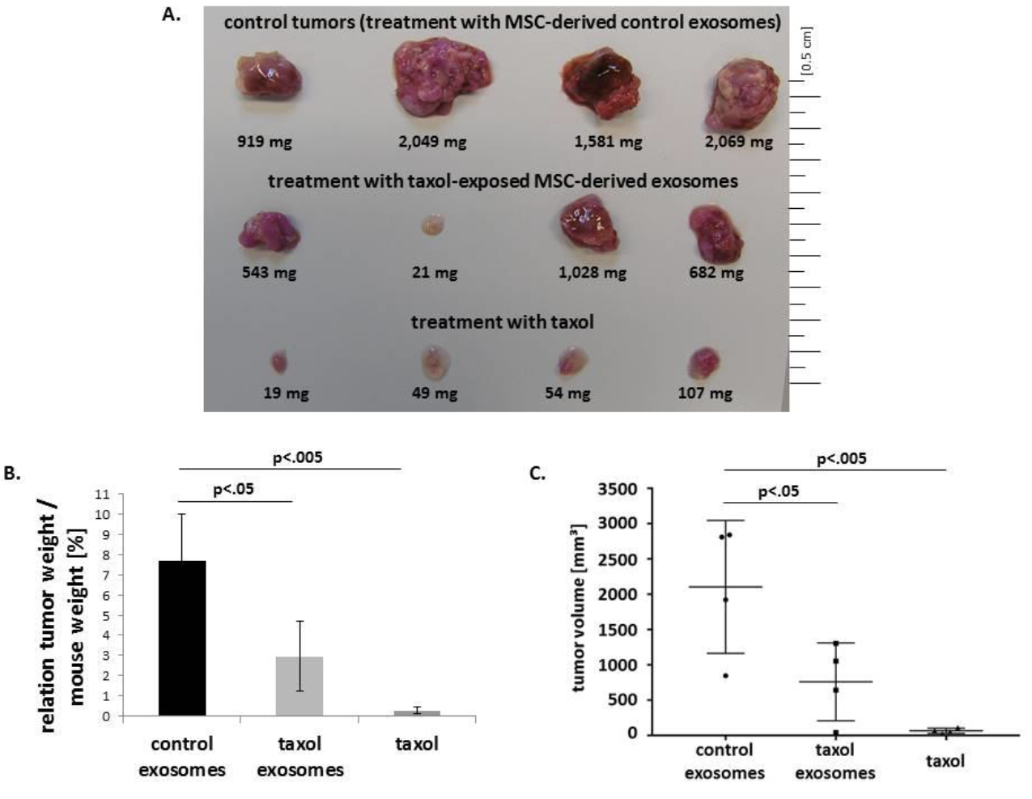
In Vivo Efficacy and Safety Evaluation
We anticipate a reduction in tumor volume and in metastasis when administering R848-loaded exosomes, at dosages lower than those used for free R848 injections
Fluorescence images of tumor, liver, spleen, kidneys, heart, and lungs of
tumor-bearing mouse models after 6h and 24h post injection
Elnaz Bagheri et al.,
Notes:
\

Slide 28
References
Turning cold tumors into hot tumors by improving T cell infiltration Yuan-Tong Liu, Zhi-Jun Sun doi: 10.7150/thno.58390
C. Peña-Romero and E. Orenes-Piñero, “Dual Effect of Immune Cells within Tumour Microenvironment: Pro- and Anti-Tumour Effects and Their Triggers,” Cancers, vol. 14, no. 7, p. 1681, 2022, doi: 10.3390/cancers14071681
Tong et al., “Tumor Associated Macrophages, as the Dominant Immune Cells, Are an Indispensable Target for Immunologically Cold Tumor—Glioma Therapy?,” Front. Cell Dev. Biol., vol. 9, p. 706286, 2021, doi: 10.3389/fcell.2021.706286
X. Shen et al., “TAM-targeted reeducation for enhanced cancer immunotherapy: Mechanism and recent progress,” Front. Oncol., vol. 12, p. 1034842, 2022, doi: 10.3389/fonc.2022.1034842
Jiachen Wen et al, “CSF1R inhibitors are emerging immunotherapeutic drugs for cancer treatment” - doi: 10.1016/j.ejmech.2022.114884 Elsevier - European Journal of Medicinal Chemistry
F. Peyraud and A. Italiano, “Combined PARP Inhibition and Immune Checkpoint Therapy in Solid Tumors,” Cancers, vol. 12, no. 6, p. 1502, 2020, doi: 10.3390/cancers12061502
Zhijie Weng et al. Therapeutic roles of mesenchymal stem cell-derive extracellular vesicles in cancer. Journal of Hematology & Oncology 2021 - doi: 10.1186/s13045- 021-01141-y
Cristiana Ulpiano et al., “Bioengineered Mesenchymal-Stromal-Cell-Derived Extracellular Vesicles as an Improved Drug Delivery System:Methods and Applications” - Biomedicines 2023 – doi: 10.3390/biomedicines11041231
Catharina Melzer et al., “Taxol-Loaded MSC-Derived Exosomes Provide a Therapeutic Vehicle to Target Metastatic Breast Cancer and Other Carcinoma Cells” - CANCERS 2019, doi: 10.3390/cancers11060798
Elnaz Bagheri et al., “Targeted doxorubicin-loaded mesenchymal stem cells-derived exosomes as a versatile platform for fighting against colorectal cancer” – Life Sciences 261 2020 – doi: 10.1016/j.lfs.2020.118369

